Slide 1
Python Pandas
Filling missing values

Slide 2


Filling with fillna() function
Filled missing value with Zero
Fill missing value using the value available in above column

Slide 3



Filling missing values---continue…..
Filling missing value using the value available in below column
Fill -99 in 5th column and -999 in 6th column

Slide 4


Filling missing values

Slide 5


Filling missing values
Limit defines how many places previous value will fill the missing values

Slide 6
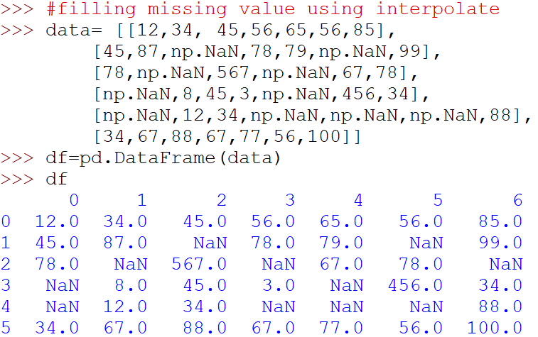
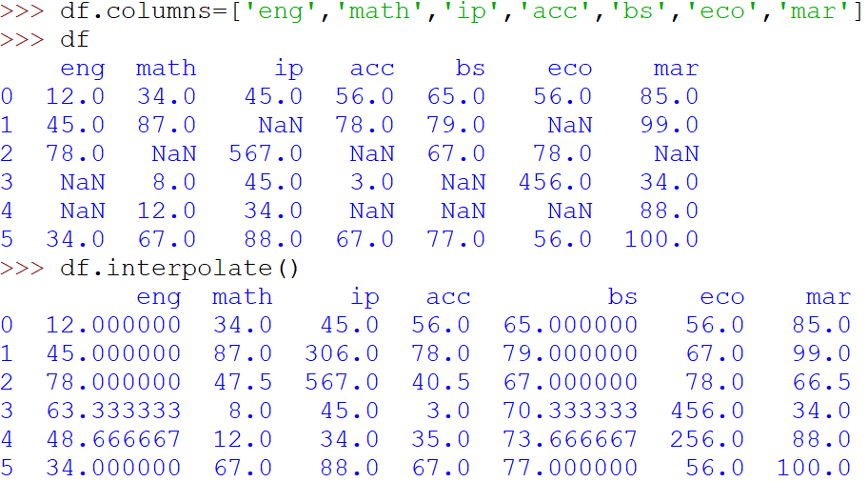

Filling missing value – using interpolate

Slide 7

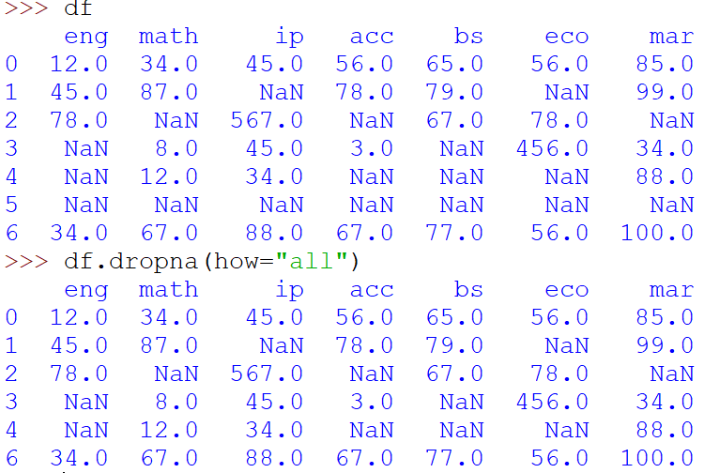
Drop missing value rows
Remove all those rows which has NaN value
Remove all those rows which has NaN in each column

Slide 8

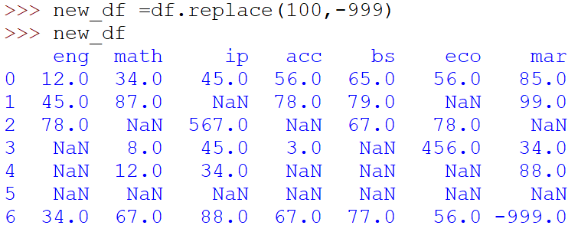
Dropping missing value column
Will hold all that row that have at-least one value

Slide 9
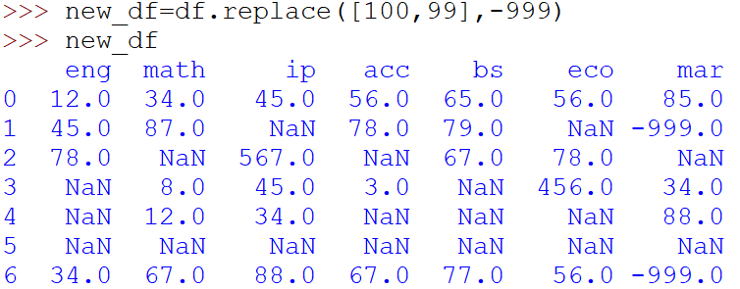
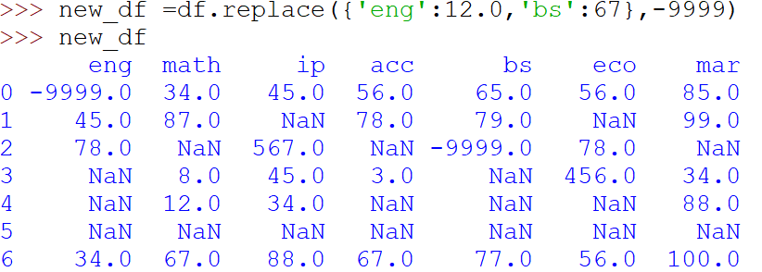
Replace values DataFrame

